Slide 1
Power Automate - Power User Module 4 – Advanced Topics
Sheldon Ledbetter Principle Customer Engineer

Slide 2

Objective
Work with Forms
Power Apps and Power Automate together
Error handling
Export and import flows

Slide 3
Forms and Power Automate

Slide 4
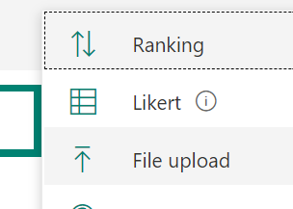
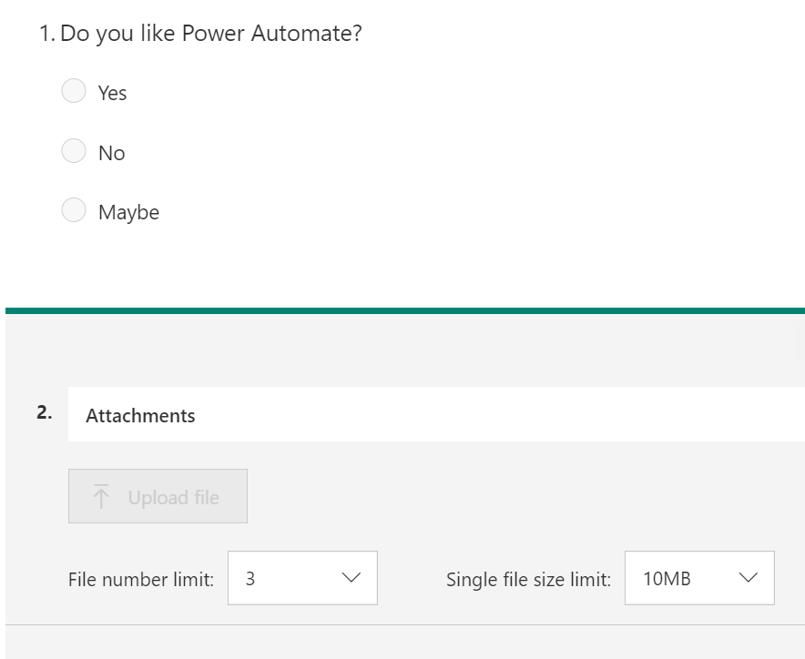
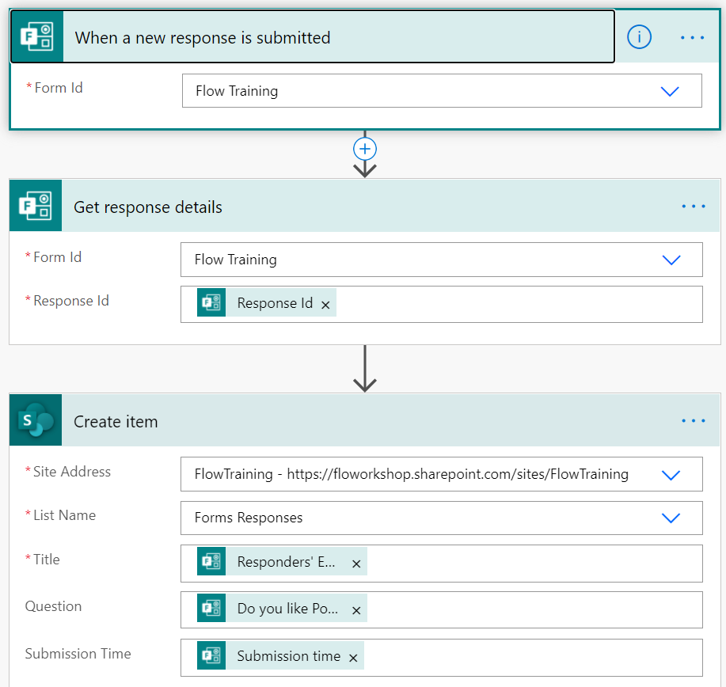
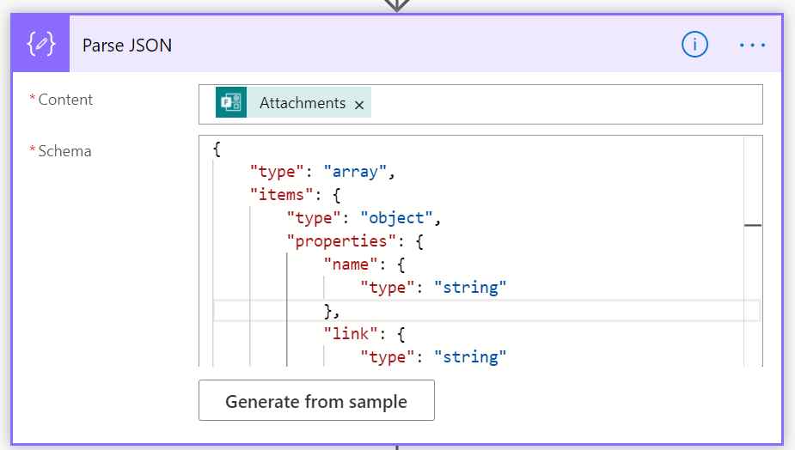
Lab 1 - Start a flow when a Form is submitted
Follow along
Open https://forms.office.com and create Form “Flow Training” with 1 Choice question and File Upload like screenshot in the right
Open https://flow.microsoft.com and create “Automated – from blank” Flow named “Forms” and select “When a new response is submitted”
Set Form Id = “Flow Training” for Forms trigger
Add new step “Get response details” (Forms)
Form Id: Flow Training
Response Id: [Response Id] (dynamic content from trigger)
Add new step “Create item” (SharePoint)
Site Address: FlowTraining
List Name: “Forms Responses”
Title: [Responders’ Email] (dynamic content from Get response detail)
Question: [Do you like Power Automate?] (dynamic content from Get response detail)
Submissions Time: [Submission time] (dynamic content from Get response detail)
Add new step “Parse JSON”
Content: [Attachments] (dynamic content from Get response detail)
Schema: {"type": "array","items": {"type": "object","properties": {"name": {"type": "string"},"link": {"type": "string"},"id": {"type": "string"}}}}
Notes:
{"type": "array","items": {"type": "object","properties": {"name": {"type": "string"},"link": {"type": "string"},"id": {"type": "string"}}}}

Slide 5
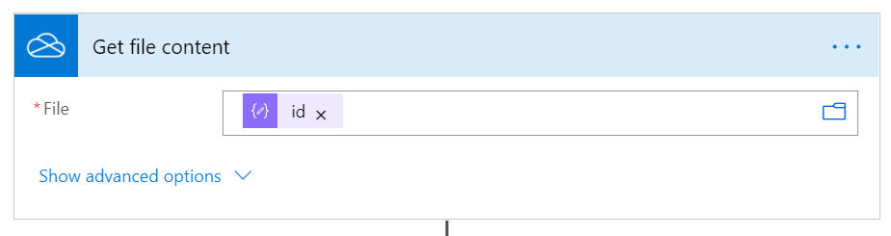
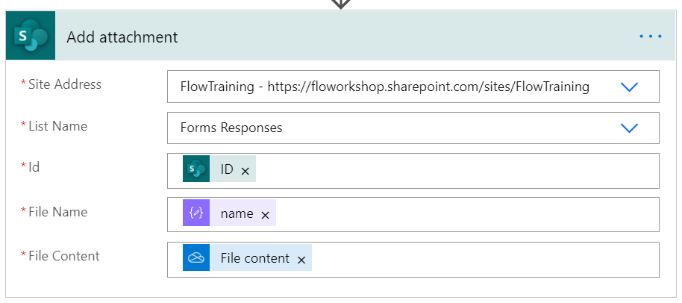
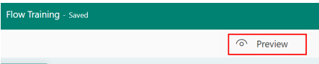
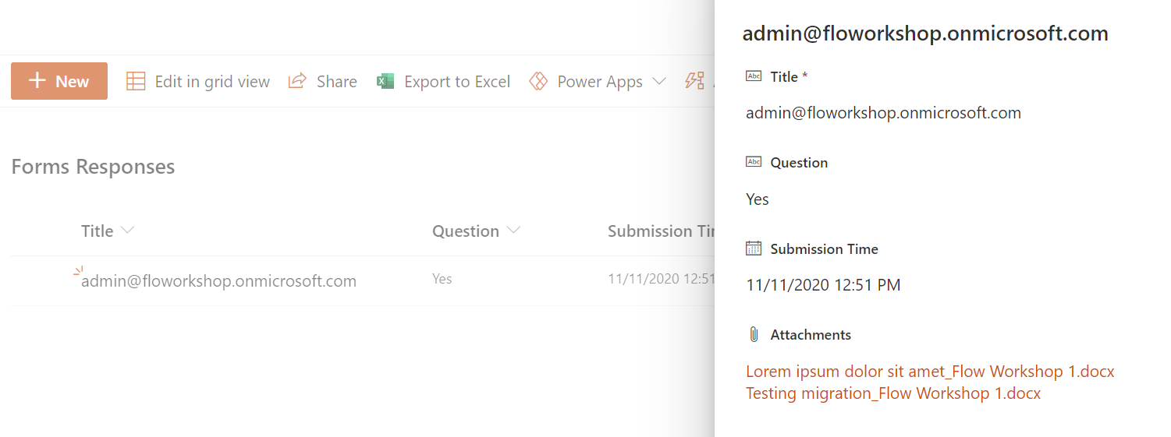
Lab 1 - Start a flow in when a Form is submitted
Follow along
7. Add new step “Get file content” (OneDrive for Business)
File: [Id] (dynamic content from Parse JSON)
NOTE, Apply to each step is automatically added after this as Parse JSON output is an array of files
8. Add new action “Add attachment” (SharePoint) after “Get file content” action inside the Apply to each loop
Site Address: FlowTraining
List Name: “Forms Responses”
Id: [ID] (dynamic content from Create item)
Subject: [name] (dynamic content from Parse JSON)
File Content: [File content] (dynamic content from Get file content)
9. Save the flow and go back to Flow Training form
10. Open form in Preview and submit a few answers with file uploads
11. Open Forms Responses list in FlowTraining site https://YOURTENANTNAME.sharepoint.com/sites/flowtraining and you should see information about submitted Form including attachments
Notes:
none

Slide 6
Flow and PowerApps

Slide 7
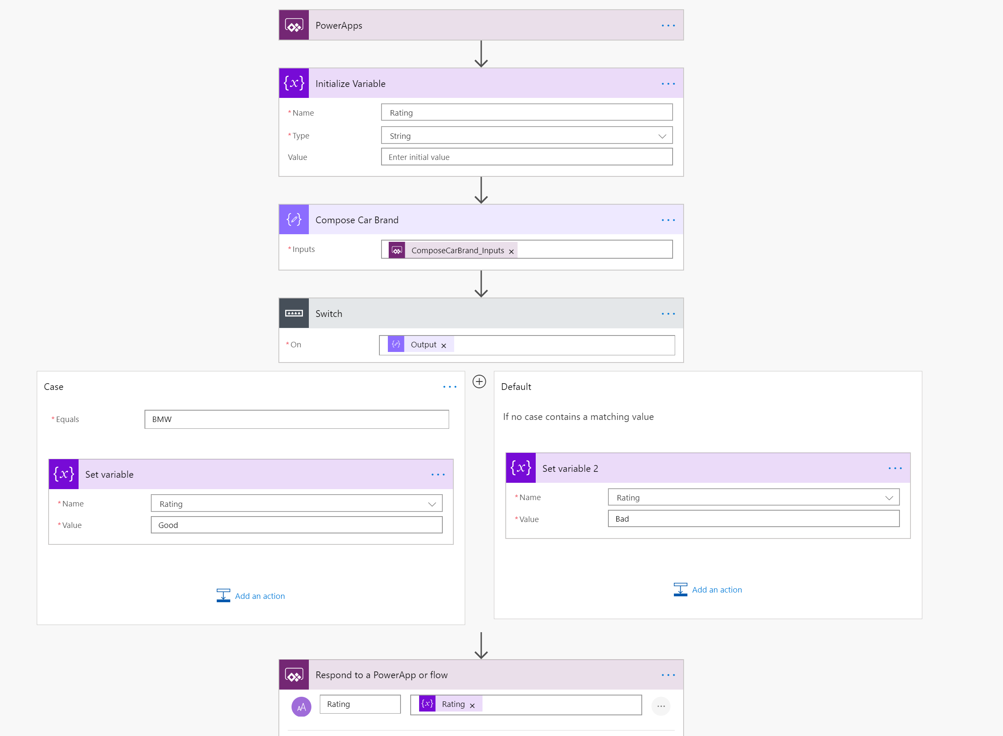


Start a Power Automate flow in PowerApps
Follow along
1. Call Flow
3. Return Data
2. Flow Process
Notes:
Follow along steps:
Logon to https://mail.powerapps.com
Logon to https://flow.microsoft.com
In Flow:
1. Create new Flow – Instant from Blank
2. Name it "PowerApp Car Rating" and select PowerApps as a trigger and click Create
3. Add step "Initialize Variable"
4. Name it Rating
5. Type String
6. Add step "Compose"
7. Rename it "Compose Car Brand"
8. Add Dynamic Content of "Ask in PowerApps"
9. Add step "Switch" and select "Output" Dynamic Content"
10. Configure Case and Default to match the screenshot above
11. Add step "Respond to a PowerApp or flow"
12. Put Rating then Rating Dynamic Content
https://docs.microsoft.com/en-us/powerapps/using-logic-flows

Slide 8
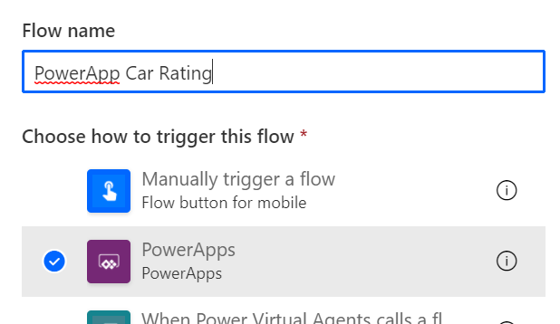
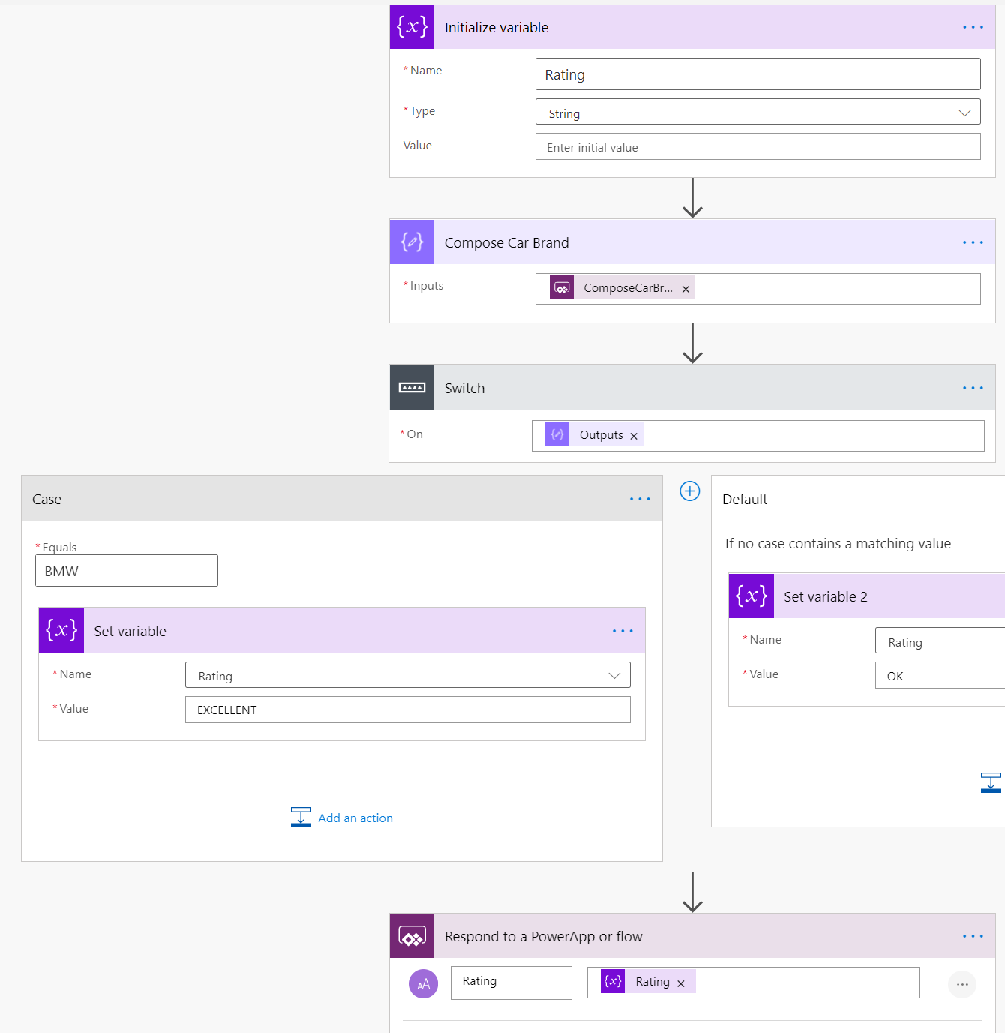
Lab 2 - Start a flow in PowerApps
Follow along
Open https://flow.microsoft.com and create new “Instant cloud flow” named “PowerApp Car Rating” and select “PowerApps” trigger
Add new step “Initialize variable” Name: Rating, Type: String
Add new step “Compose” and rename action to “Compose Car Brand”
Inputs: [Ask in PowerApps] (dynamic content)
Add new step “Switch” (Control)
Case: BMW
Add new “Set variable” step to Case branch and select Rating variable and set its value to EXCELLENT
Add new “Set variable” step to Default branch and select Rating variable and set its value to OK
Add new step “Respond to a PowerApp or Flow”
Add new Text Input named “Rating” and set its value to Rating variable
Open https://make.powerapps.com

Slide 9
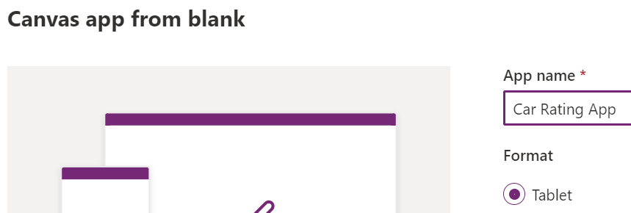
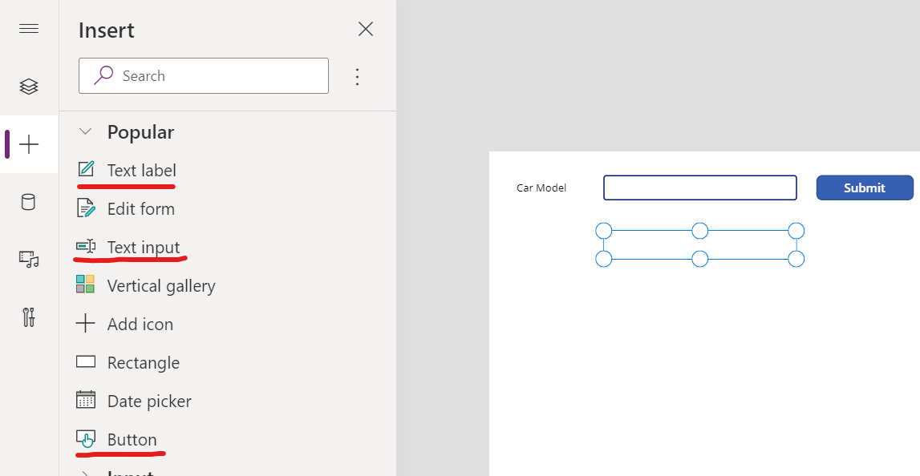
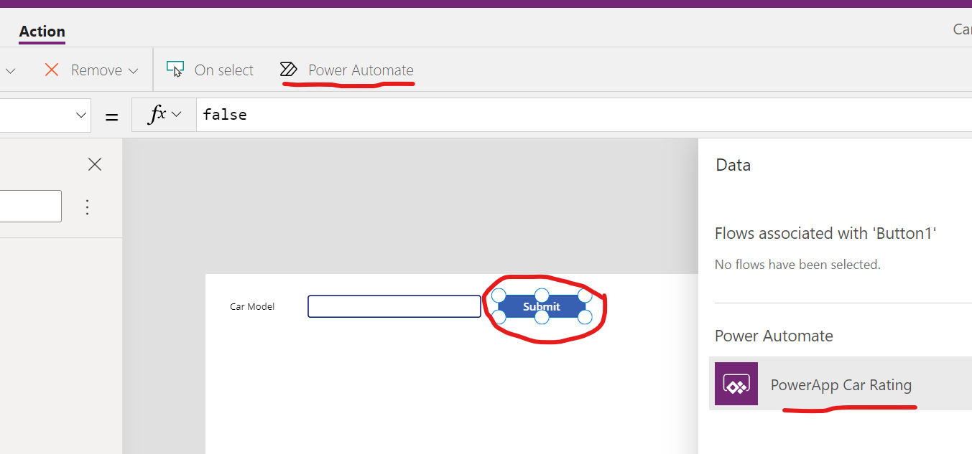
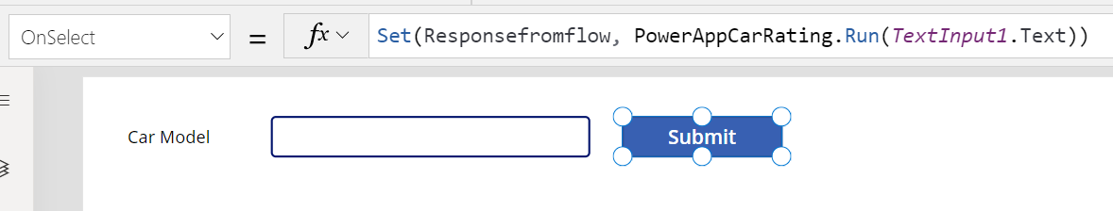
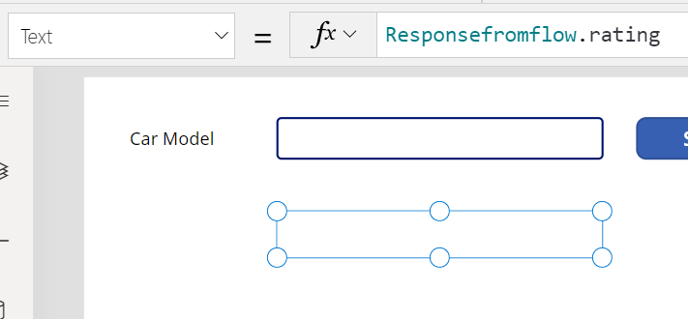
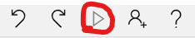
Lab 2 - Start a flow in PowerApps
Follow along
Create new Canvas app from blank with Tablet layout and name the app as “Car Rating App”
Add following controls to screen
Text label: “Car Model”
Text input
Button: “Submit”
Text label: “”
Select Button and attach your Flow to it Action > Power Automate > “PowerApp Car Rating”
Set Button’s OnSelect: Set(Responsefromflow, PowerAppCarRating.Run(TextInput1.Text))
Select the second Text label (under text input) and set its Text: Responsefromflow.rating
Test the App by clicking Play button on top right corner
Test app by typing “BMW” to textbox and press Submit. Test with other car brands as well

Slide 10
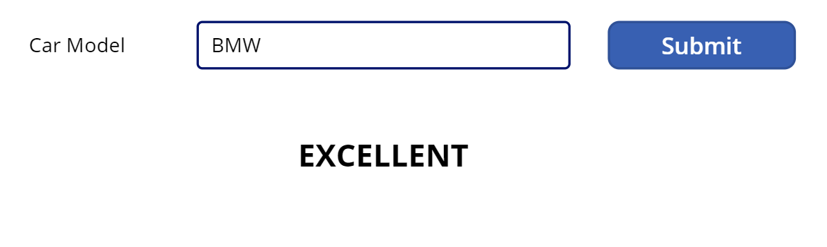
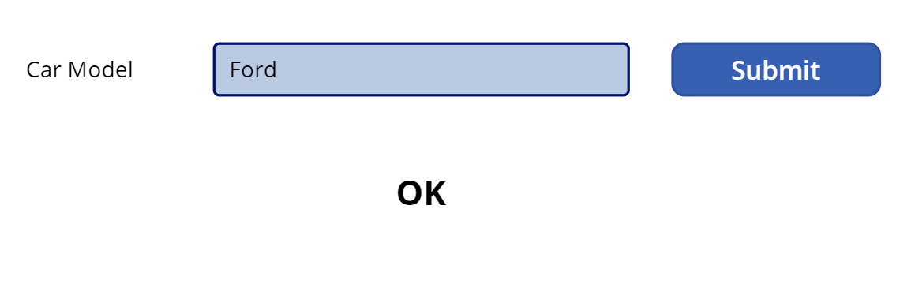
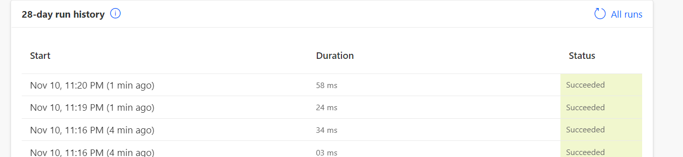
Lab 2 - Start a flow in PowerApps
Follow along
1. Call Flow
3. Return Data
2. Flow Process

Slide 11
Advanced Actions

Slide 12
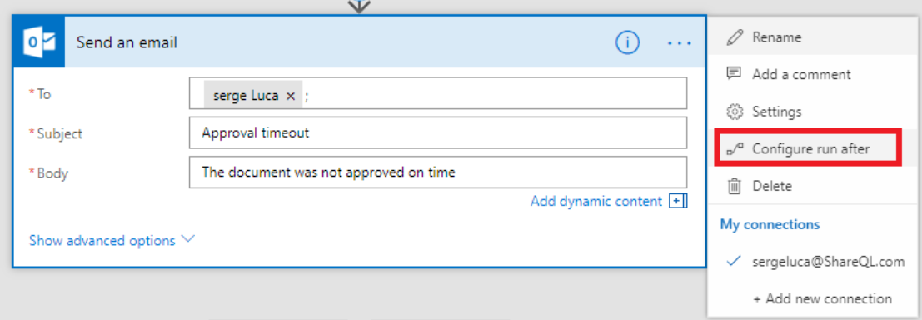
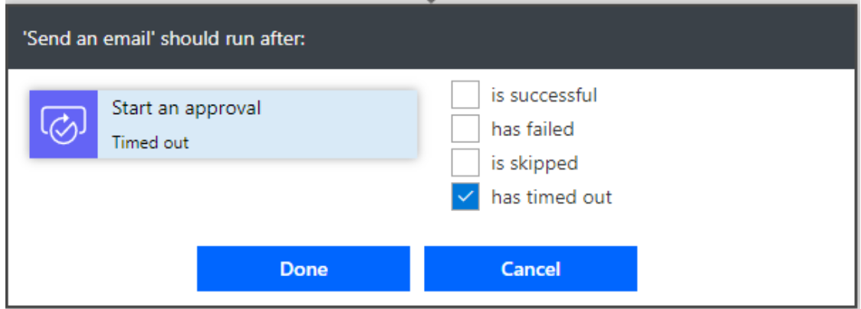
Error handling: use “Configure run after”
Flow run time is limited to 30 days

Slide 13
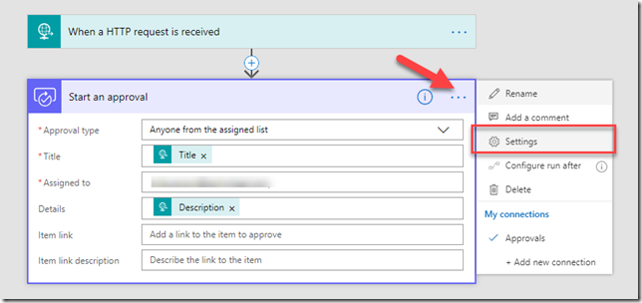
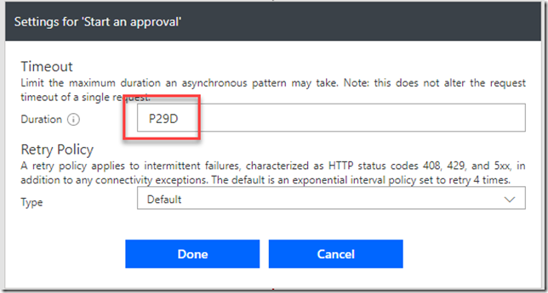
Approval expiring
The default max timeout is 30 days in Microsoft Flow.
But you can change the timeout.
If you set the action timeout to 29 days it’s guaranteed to timeout before the whole flow times out. To test it out you can set the timeout lower, for example 15 minutes (PT15M).

Slide 14
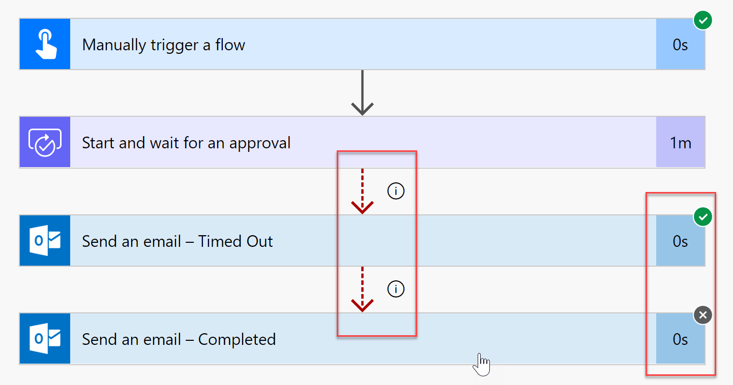
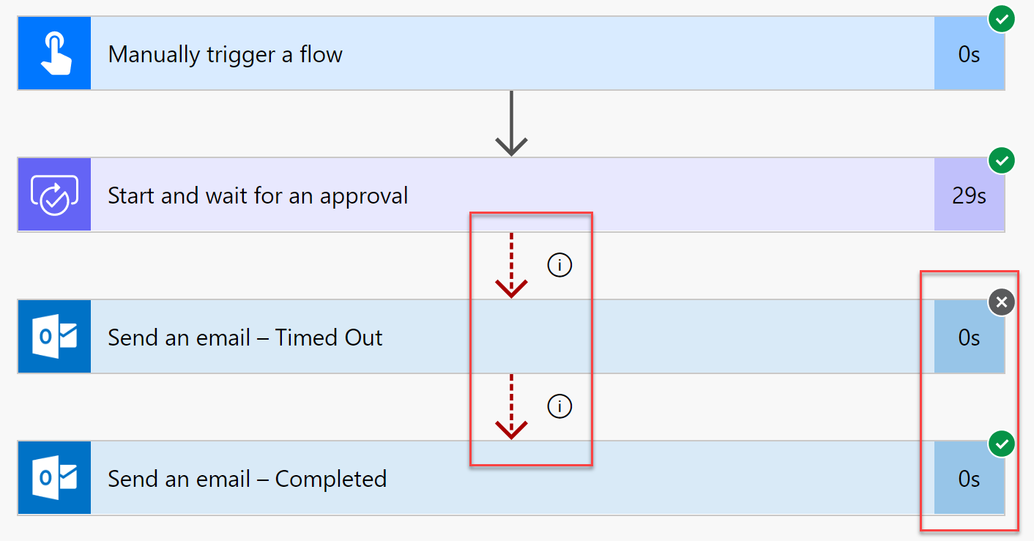
Error handling
Follow along
Notes:
Follow along steps: ​
​
Click on My flows at https://flow.microsoft.com after signing into your Tenant​
Click New | Instant-from blank​
Name the Flow “Error handling"​
Select "Manually trigger a flow" from the list​
Click Create​
Click "New Step"​
Type "approval" and then select "Start and wait for an approval"​
In Approval type, click drop down box and select "Approve/Reject - First to respond"​
Click “…” in the approval action and click “settings”
Change the timeout duration to 1 minute : PT1M – click done
Click "New Step"​
Add the action “Send an email”
Add your self in the “To”
Set subject to “The approval flow has timed out”
Add the dynamic content “Title” from the approval action
Click “…” in the “send an email action” and click rename – and rename to “Send an email – Timed Out”
Click “…” in the “send an email action” and click “Configure run after”
Select only “has timed out”
Click "New Step"​
Add the action “Send an email”
Add your self in the “To”
Set subject to “The approval flow has completed”
Add the dynamic content “Title” from the approval action
Click “…” in the “send an email action” and click rename – and rename to “Send an email – Completed”
Click “…” in the “send an email action“ action and click “Configure run after”
Select only “is skipped”
Test the flow 2 times, one where you approve in the email, and one where you wait for more than 1 minute to see the timeout
NOTE: sometimes the approval email is very slow (5-10 minutes)

Slide 15
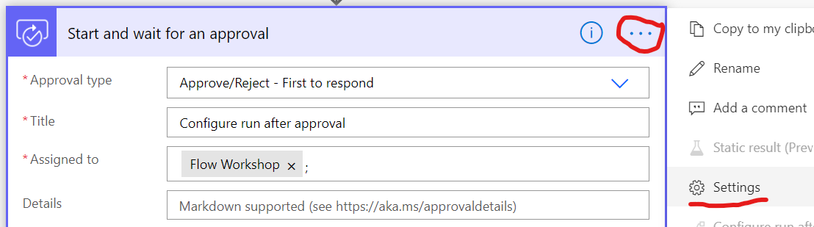
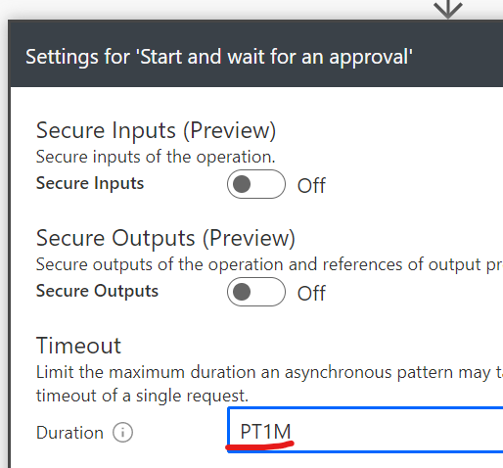
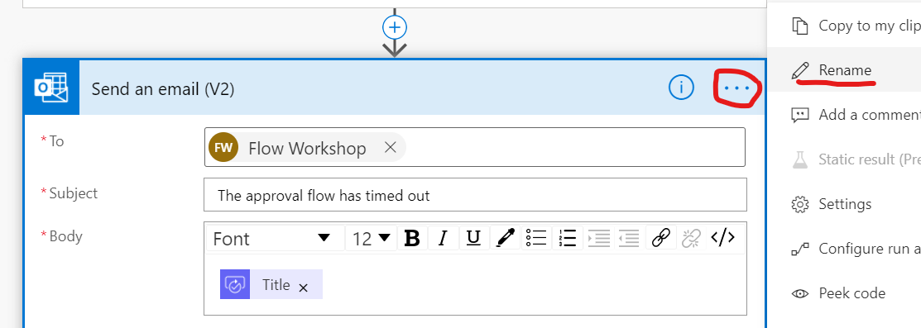
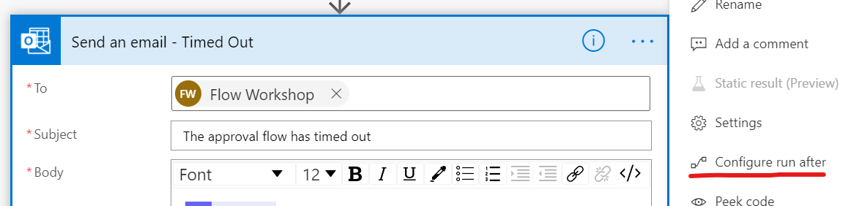
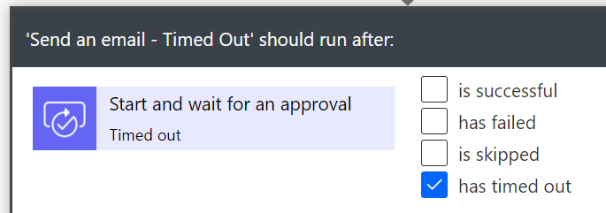
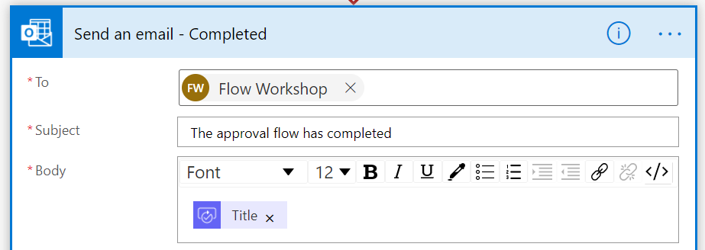
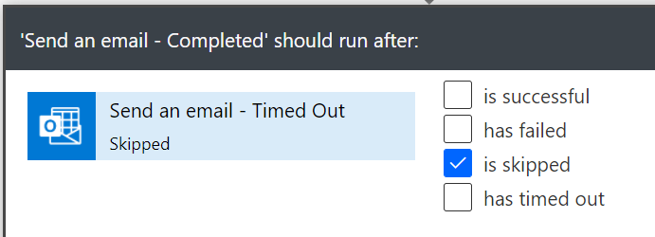
Lab 3 – Error Handling
Follow along
Create new “Instant cloud flow” named “Error handling” and select “Manual trigger a Flow”
Add new step “Approval”
Approval type: Approve/Reject – First to respond
Title: Run after approval
Assigned to: Your O365 account
Click … select Settings and set Timeout: PT1M
Add new step “Send an email (V2)”
To: Your O365 email address
Subject: “The approval flow has timed out”
Body: [Title] (dynamic content from Approval)
Click … select Rename and rename action to “Send an email – Timed Out”
Click … select Configure run after and select only “has timed out”
Add new step “Send an email (V2)”
To: Your O365 email address
Subject: “The approval flow has completed”
Body: [Title] (dynamic content from Approval)
Click … select Rename and rename action to “Send an email – Completed”
Click … select Configure run after and select only “is skipped”
Notes:
Follow along steps:
Create a new flow with the trigger – Flow Button
Add action – SharePoint Get items
Add the site FlowTraining and list LargeList
Add action Compose to count the number of items collected from the list. Add the Expression : length(body('Get_items')?['value’])
Run the flow and show that List only 100 items there is collected , but you can add up to 5000. So blank means 100

Slide 16
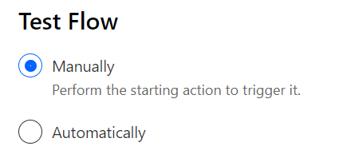
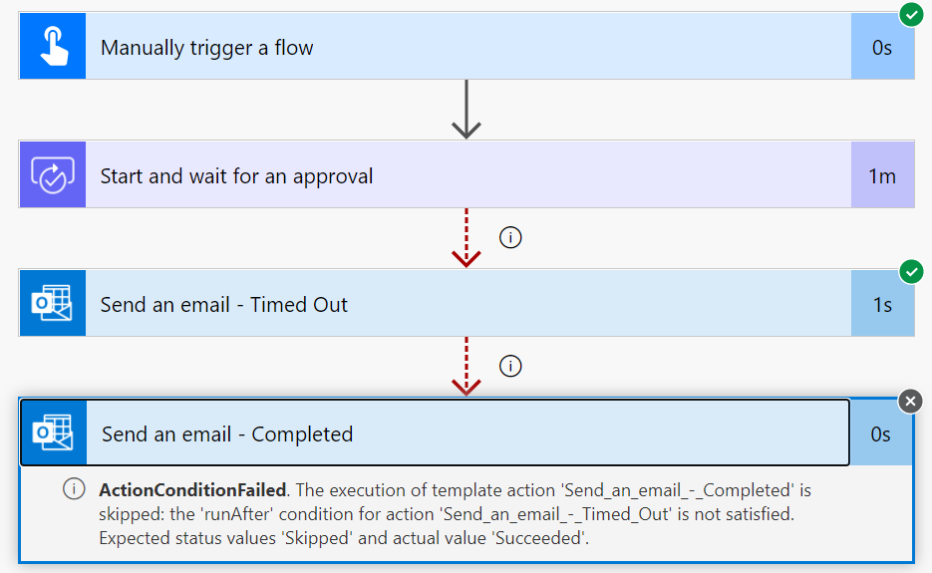
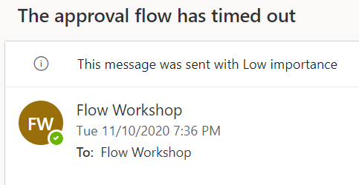
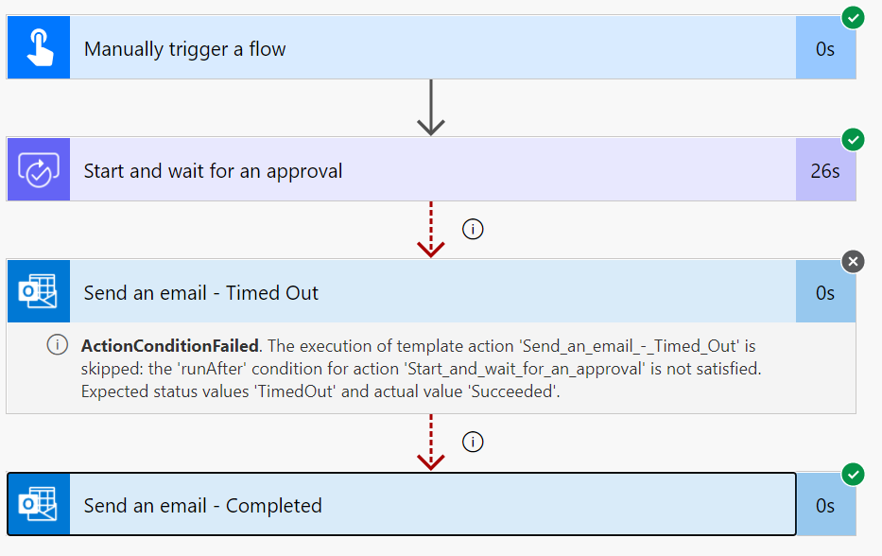
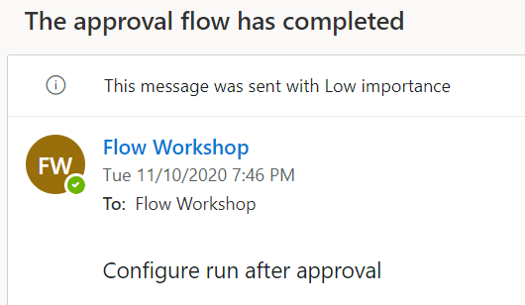
Lab 3 – Error Handling
Follow along
5. Save and test the Flow 2 times
6. Test #1
Run the Flow and wait until execution is finished in about 1 minute. You should see approval email sent to your O365 email but do not approve/reject it, as we want that approval step to timeout. When “Send an email – Timed Out” step is executed, the run after configuration “Send an email – Completed” step is not executed.
7. Test #2
Run the Flow a second time. You should see approval email sent to your O365 email. This time, approve/reject the email from your inbox. Then you will see “Send an email – Timed Out” step will be skipped. The “Send an email – Completed” step is executed because of run after configuration.
Notes:
Follow along steps:
Create a new flow with the trigger – Flow Button
Add action – SharePoint Get items
Add the site FlowTraining and list LargeList
Add action Compose to count the number of items collected from the list. Add the Expression : length(body('Get_items')?['value’])
Run the flow and show that List only 100 items there is collected , but you can add up to 5000. So blank means 100

Slide 17
Export & Import Flow

Slide 18
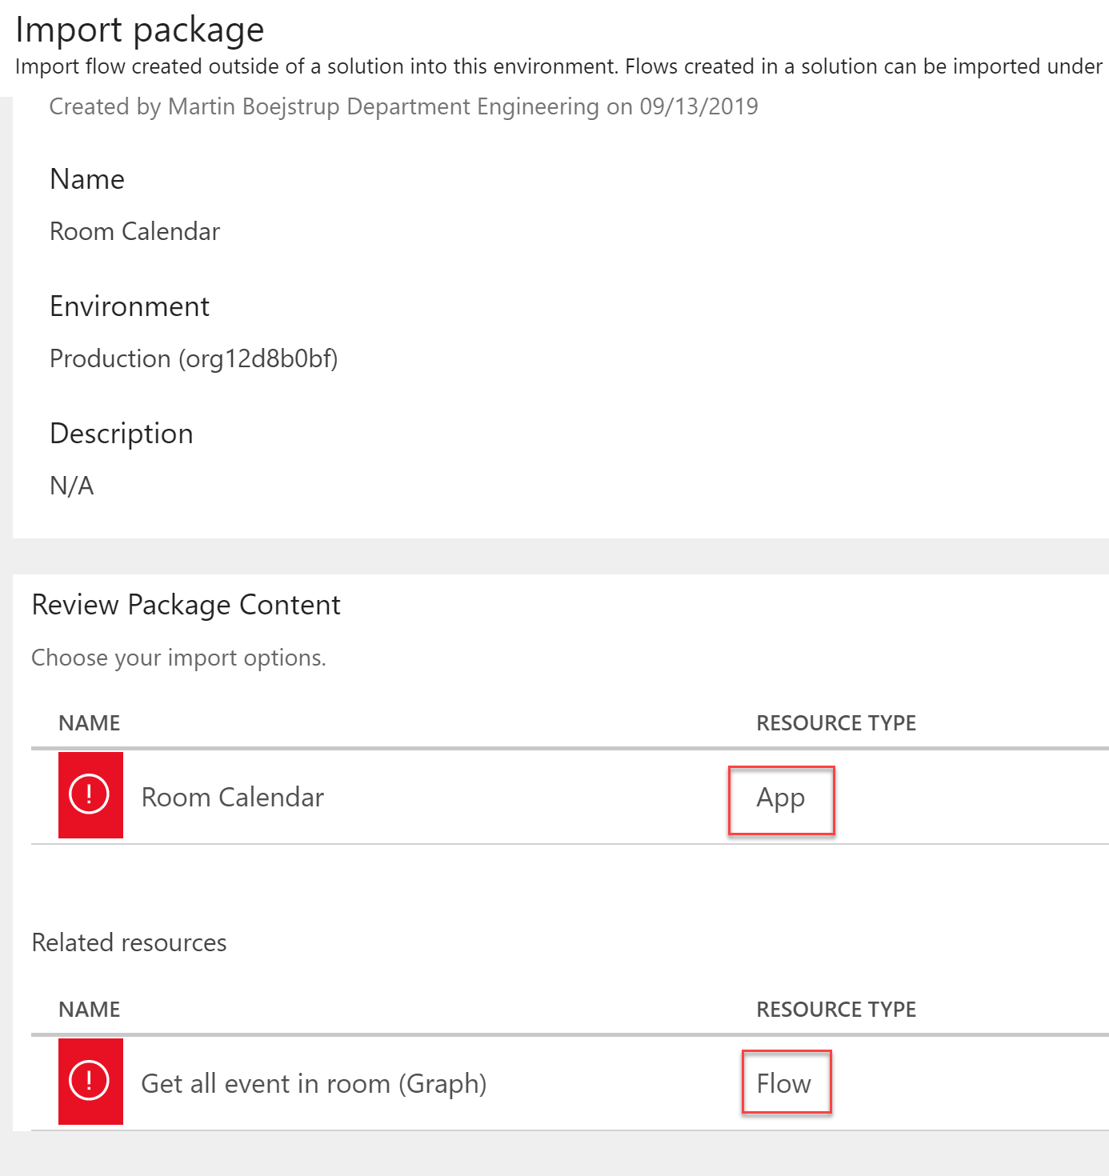
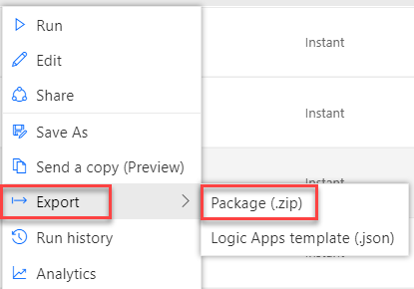
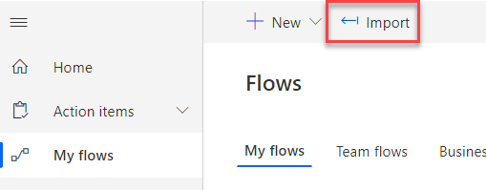
Export & import Flow Package
Follow along
A Flow package can also contain PowerApps if they are connected.
Notes:
Follow along steps: ​
Show how to export and import flow package

Slide 20
Optional “Follow along” Extra if you have time

Slide 21
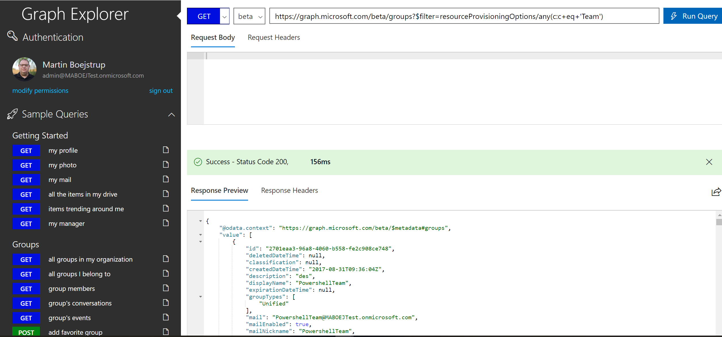
Working with Microsoft Graph
Follow along
User Graph Explore to test – http://aka.ms/ge.

Slide 22
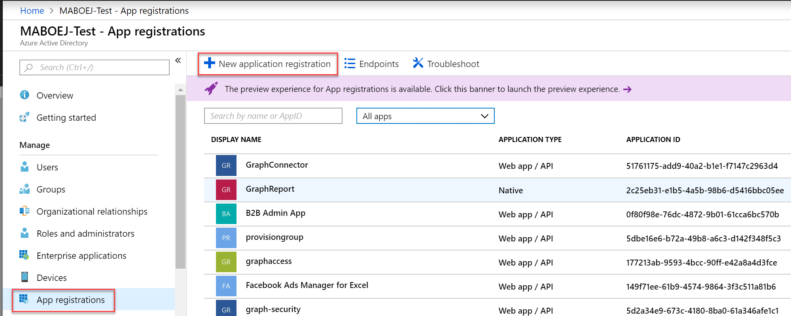
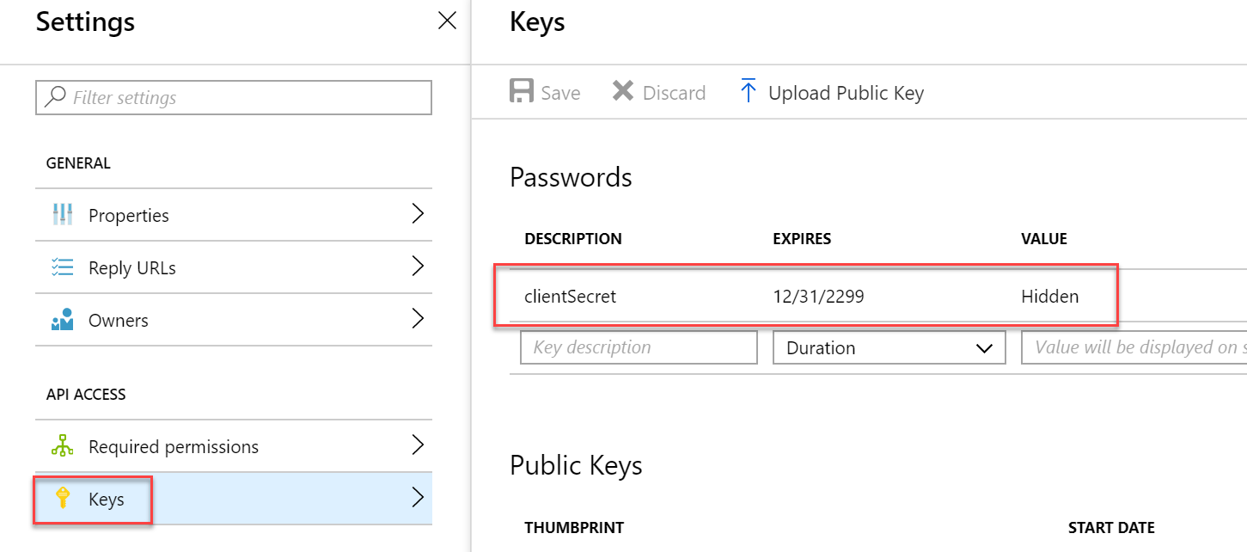
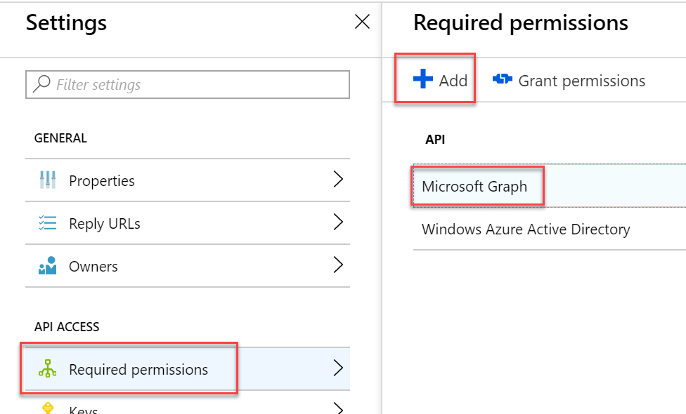
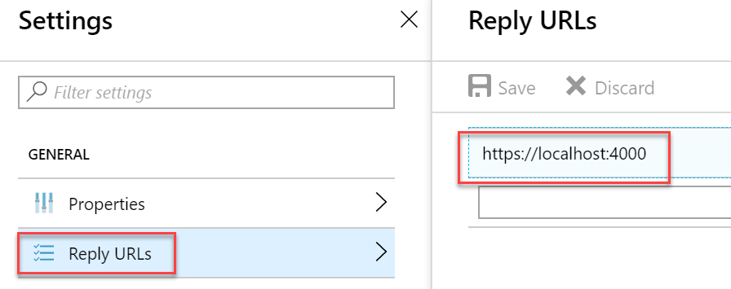
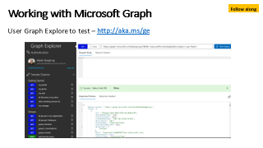
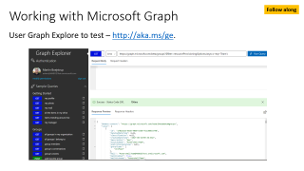
Working with Microsoft Graph
Follow along
You need to create an App in Azure AD

Slide 23
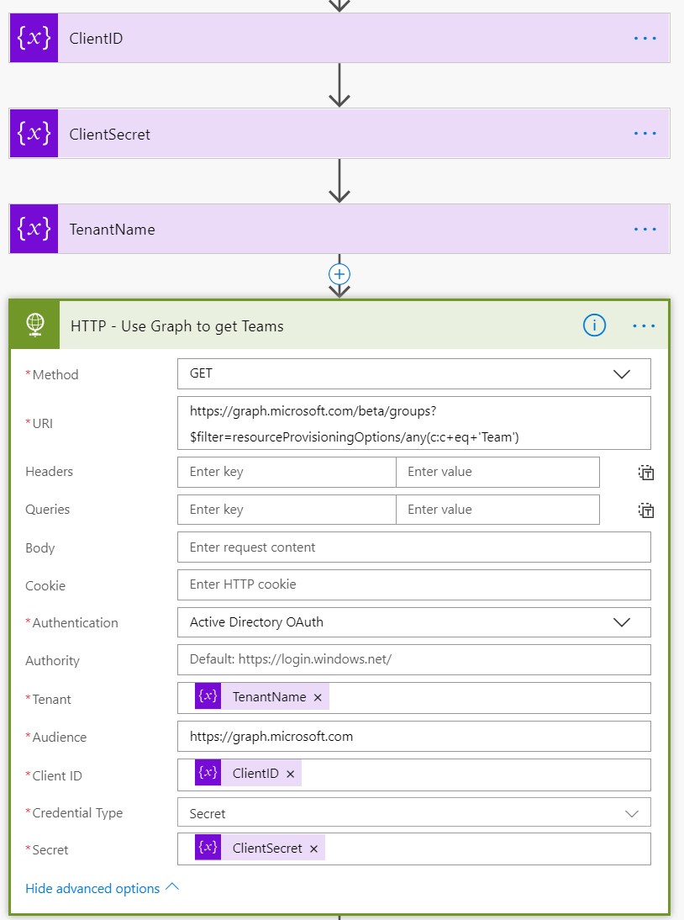
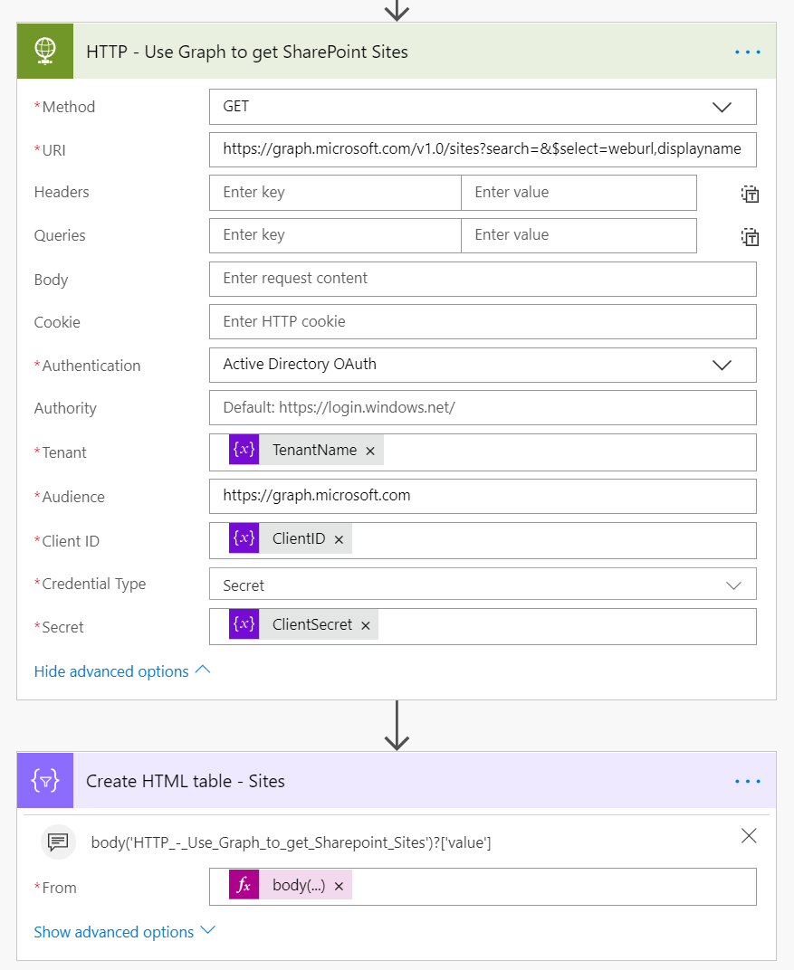
Working with Microsoft Graph
Follow along

Slide 24
Working with Microsoft Graph
Follow along
Get teams: https://graph.microsoft.com/beta/groups?$filter=resourceProvisioningOptions/any(c:c+eq+'Team’)
Search Groups:
https://graph.microsoft.com/v1.0/groups?$filter=startswith(displayName,'New’)
https://graph.microsoft.com/v1.0/groups?$filter=displayName eq 'new phones’
Get Sites:
https://graph.microsoft.com/v1.0/sites?search=
Search sites:
https://graph.microsoft.com/v1.0/sites?search=aaa222&$select=weburl,displayname

